Slide 1


Rare Events in Monte Carlo Methods with Applications to Circuit Simulation
Todd McKenzie, PhD Candidate Graduate Institute of Computer Science and Information Engineering
National Taiwan University
PhD Advisor : Professor Yung-jen (Jane) Hsu [NTU]
Manager/Mentor : Dr. Kishore Singhal [Synopsys]

Slide 2
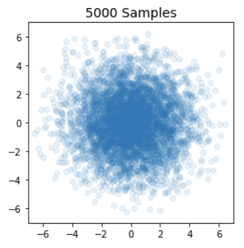
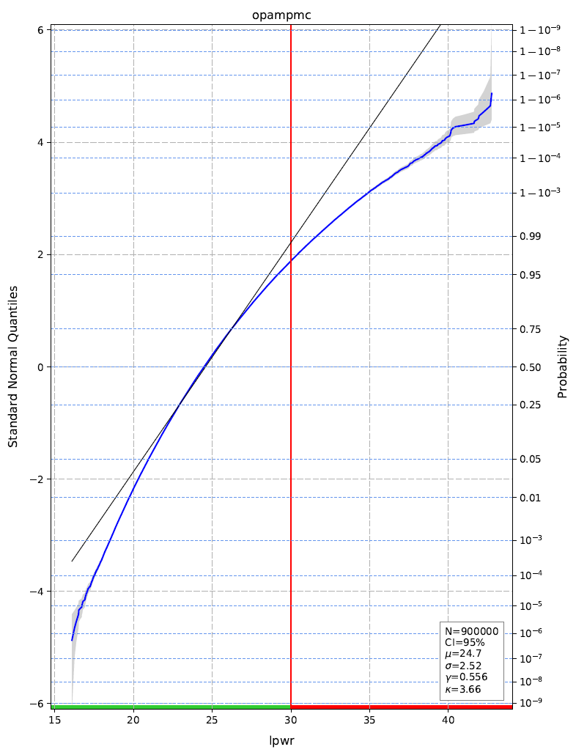
What are "rare events" in Monte Carlo simulation?
Assume : input distribution is multivariate standard normal
Rare events in the input space:
Samples which are distant from the origin (in n dimensions)
Rare events in the output space:
Samples which are in the tail region of the output distribution (in a single dimension)

Slide 3



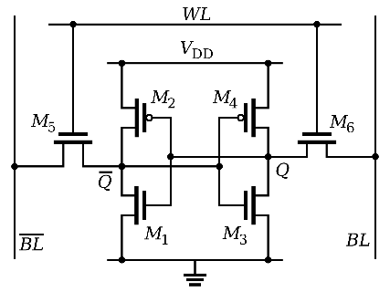
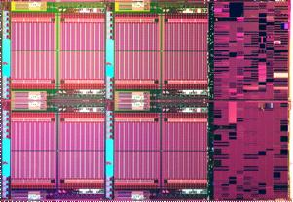
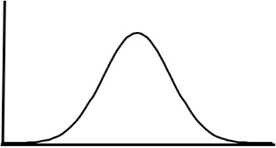
Problem #1 : How to investigate rare Monte Carlo events given a limited simulation budget?
Stringent automotive safety standards such as ISO26262 and highly replicative circuits like SRAM arrays drive simulation to 6 sigma and beyond (<0.0000001% failure rate requirement)
In semiconductor simulation, process variation is most often modeled via standard normal random variables
In such a scenario, simulating Monte Carlo samples which fail circuit requirements by conventional sampling requires billions of simulations
As performing so many simulations may not be feasible, we propose a novel method for investigating such rare failure samples

Slide 4

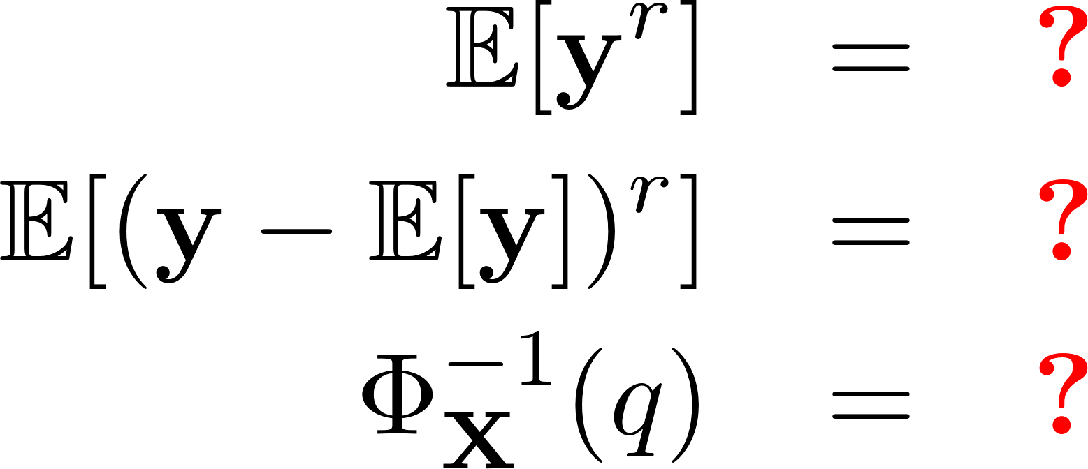
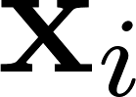
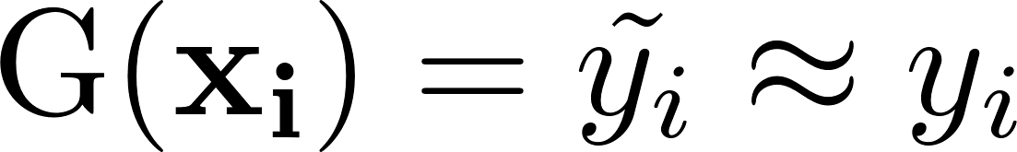
Problem #2 : How to model and characterize quadratic forms of multivariate standard normal random variables?
True System
Surrogate
Model
The Surrogate Model should be faster than True System evaluation
Can be Taylor series approximation (linear, quadratic, ...) or general model (SVM, CNN, Random Forest, ...)
It is well known that if G is linear, these questions can be answered easily
More generally, if G is quadratic, the problem is also tractable
We design a flow for the modeling and providing statistical characterization a quadratic forms of multivariate standard normal random variables

Slide 5
Problem #3 : How to calculate mean, standard deviation, skewness, and kurtosis efficiently from quantile information?
Mean
Standard Deviation
Skewness
Kurtosis
?
Can such information be extracted from quantile information alone (i.e. from a QQ plot) ?

Slide 6
Outline
Topic #1 : Alternative Monte Carlo Sampling Techniques
Topic #2 : Modeling and Characterization of Quadratic Forms
Topic #3 : Moment Calculation from Quantile Information
Circuit Applications
Conclusions

Slide 7
Topic #1 : Alternative Monte Carlo Sampling Methods

Slide 8
Sampling
For circuit simulation application, while the distribution of the process variables is provided by the foundry and generally assumed to be normal, the distribution of the response is usually not known analytically
The response distribution and appropriate statistical measures like moments and percentiles are determined by Monte Carlo sampling
One mimics the manufacturing process on the computer by
Generating random numbers for the process variables
Simulating the circuit with these random variables
Post-processing the output once sufficient number of samples have been simulated

Slide 9
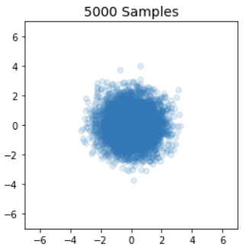
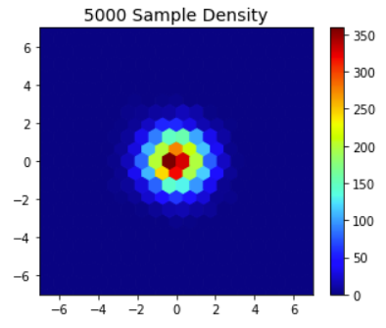
Simple Random Sampling (SRS)
SRS produces a majority of samples near the origin

Slide 10
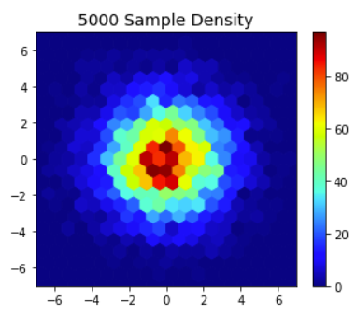
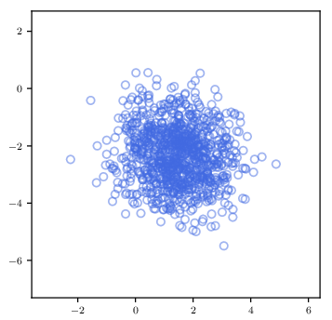
Related Work : Importance Sampling
Importance Sampling Example 1 : Scaling (sigma > 1)
Scaling : Increasing the sigma value shifts SRS samples further from the origin, however they remain concentrated near the origin
Translation : Samples concentrated at shift origin rather than at (0,0,...,0) ; requires training samples and analysis to decide location of new origin(s)
Importance Sampling Challenges
Need to decide shift origin and/or scale magnitude (requires training samples)
Resulting measure distribution different than that of SRS
Importance Sampling Example 2 : Translation

Slide 11
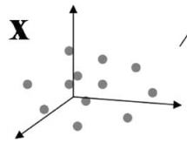
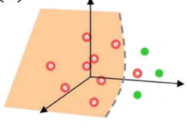
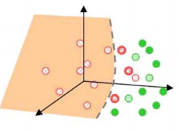
Related Work : Statistical Blockade
Steps:
Simulate training samples
Build surrogate model based on training samples
Predict results of large Monte Carlo sample set
Filter predictions of large Monte Carlo sample set (retain only predictions in the tail)
Simulate predicted tail samples
Summarize tail sample statistics (quantile extraction or yield computation)
Statistical Blockade Challenges:
Predicated on building accurate surrogate model
Must predict ALL samples, can become bottleneck at high sigma

Slide 12
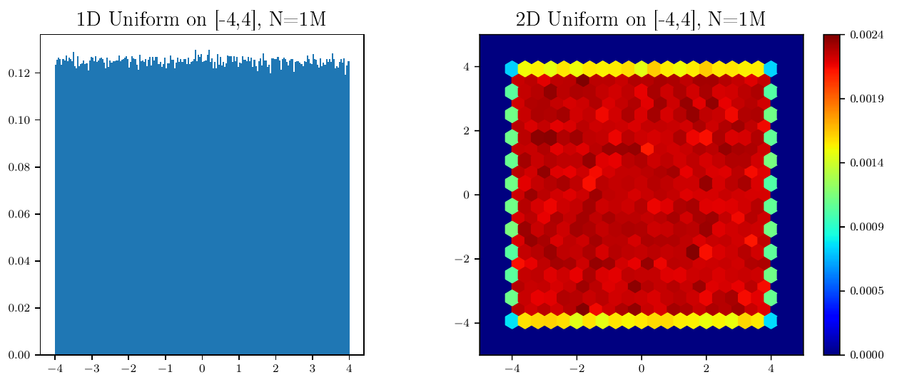
Uniform Random Sampling (1/2)
Uniform random variable densities shown to the right for 1D and 2D
Select uniform random samples in d dimensions simply by choosing d uniform random variables

Slide 13
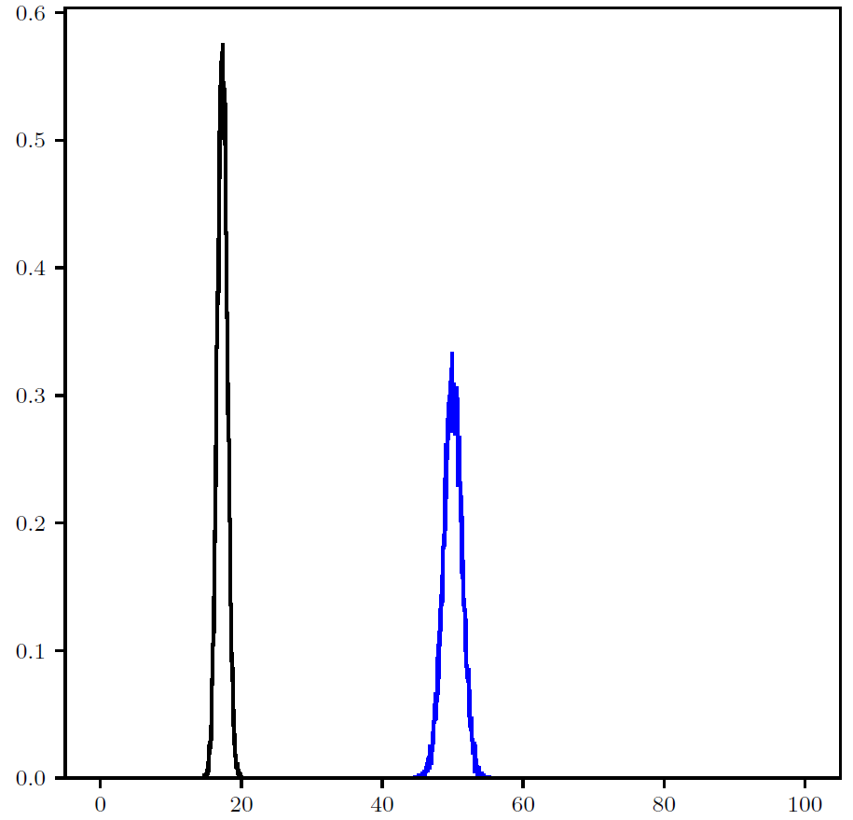
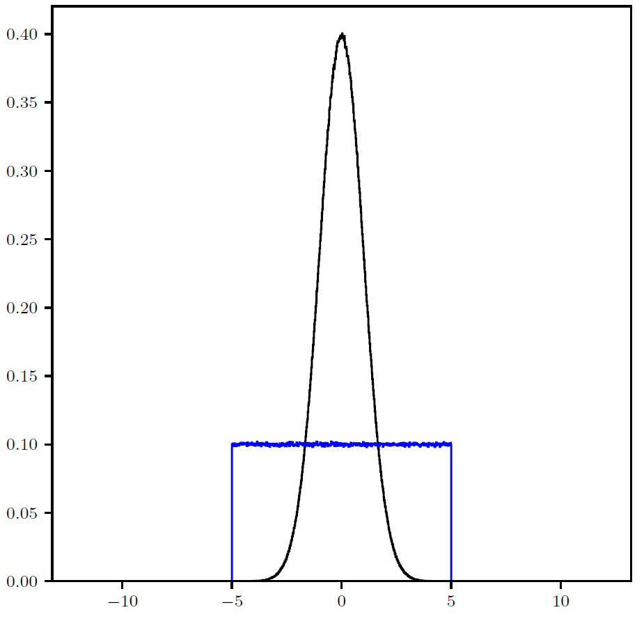
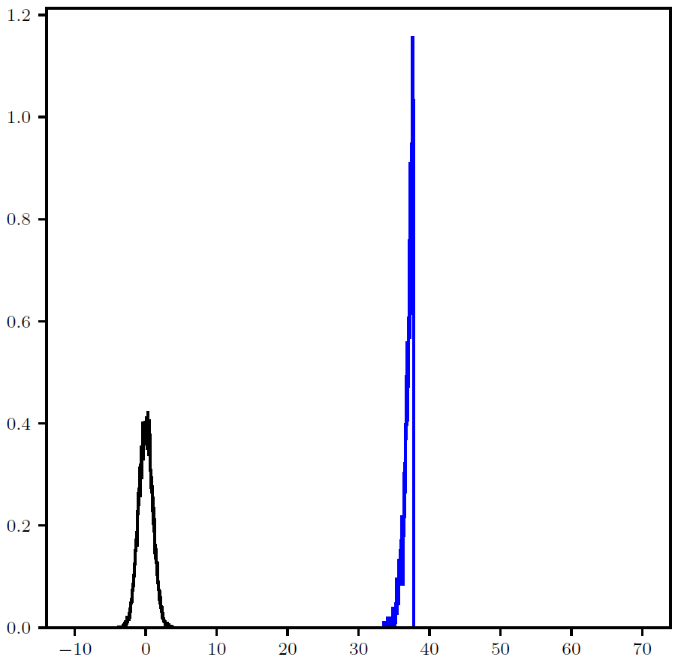
Uniform Random Sampling (2/2)
300D : Distance from Origin
Uniform random variables in higher dimensions depart significantly from normal
Statistical inferences are no longer practical
In this example in 300 dimensions, the majority of uniform samples exceed 30 sigma (which has a likelihood of 1 in 10¹⁹⁷)
1D : Probability density
Normal
Uniform
Normal
Uniform
300D : Normal sigma equivalent of Distance from Origin
Normal
Uniform

Slide 14
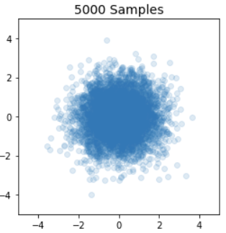
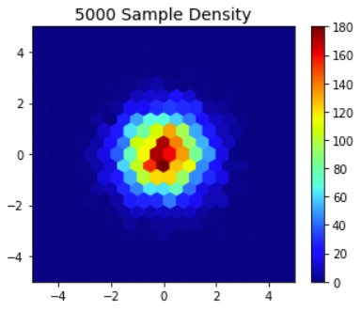
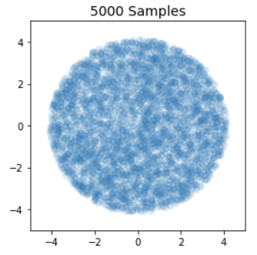
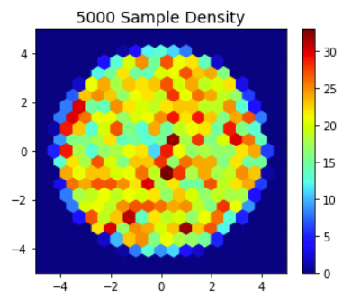
Hyperspheric Uniform Random Sampling
Simple Random Sampling
Hyperspheric Uniform Random Sampling produces samples which are evenly distributed in the input IRV space, without inclusion of extremely rare samples
Provides good coverage further away from the origin which is often the region of interest
Can be used to create training datasets for classification, regression and importance sampling surrogate models
Reduced samples in regions of less interest leads to better models as error metric is not dominated by such samples
Hyperspheric Uniform Random Sampling

Slide 15
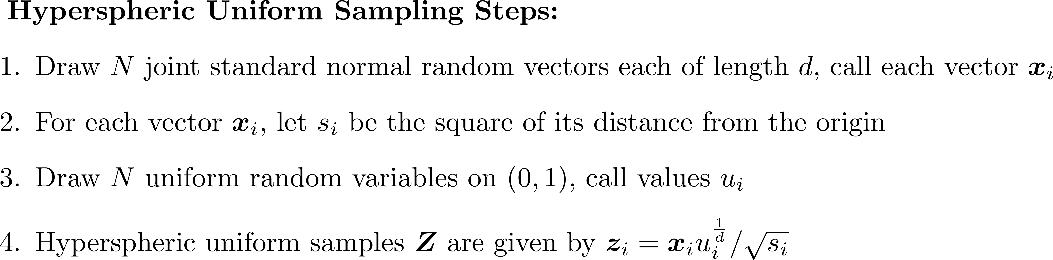
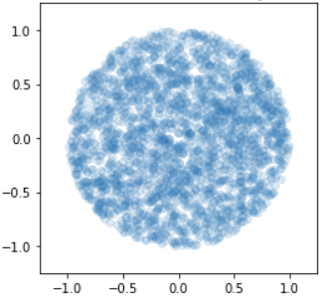
Drawing Hypherspheric Uniform Samples
Harman, Radoslav, and Vladimír Lacko. "On decompositional algorithms for uniform sampling from n-spheres and n-balls." Journal of Multivariate Analysis 101.10 (2010): 2297-2304.

Slide 16
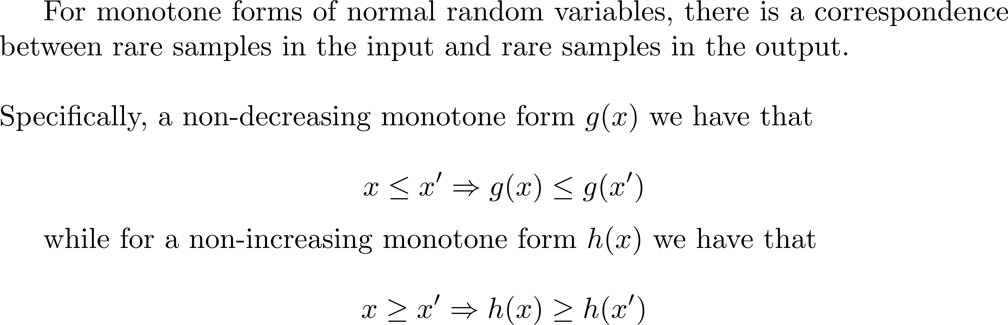
Motivation for Rare Sample Simulation : 1D

Slide 17
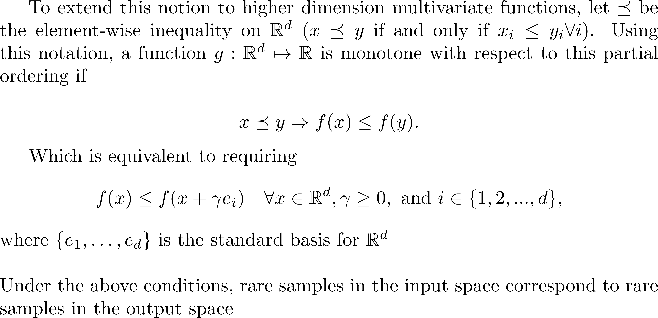
Motivation for Rare Sample Simulation : Higher Dimensions
-> Monotonic Property is Key to Linking Rare Inputs with Rare Outputs

Slide 18
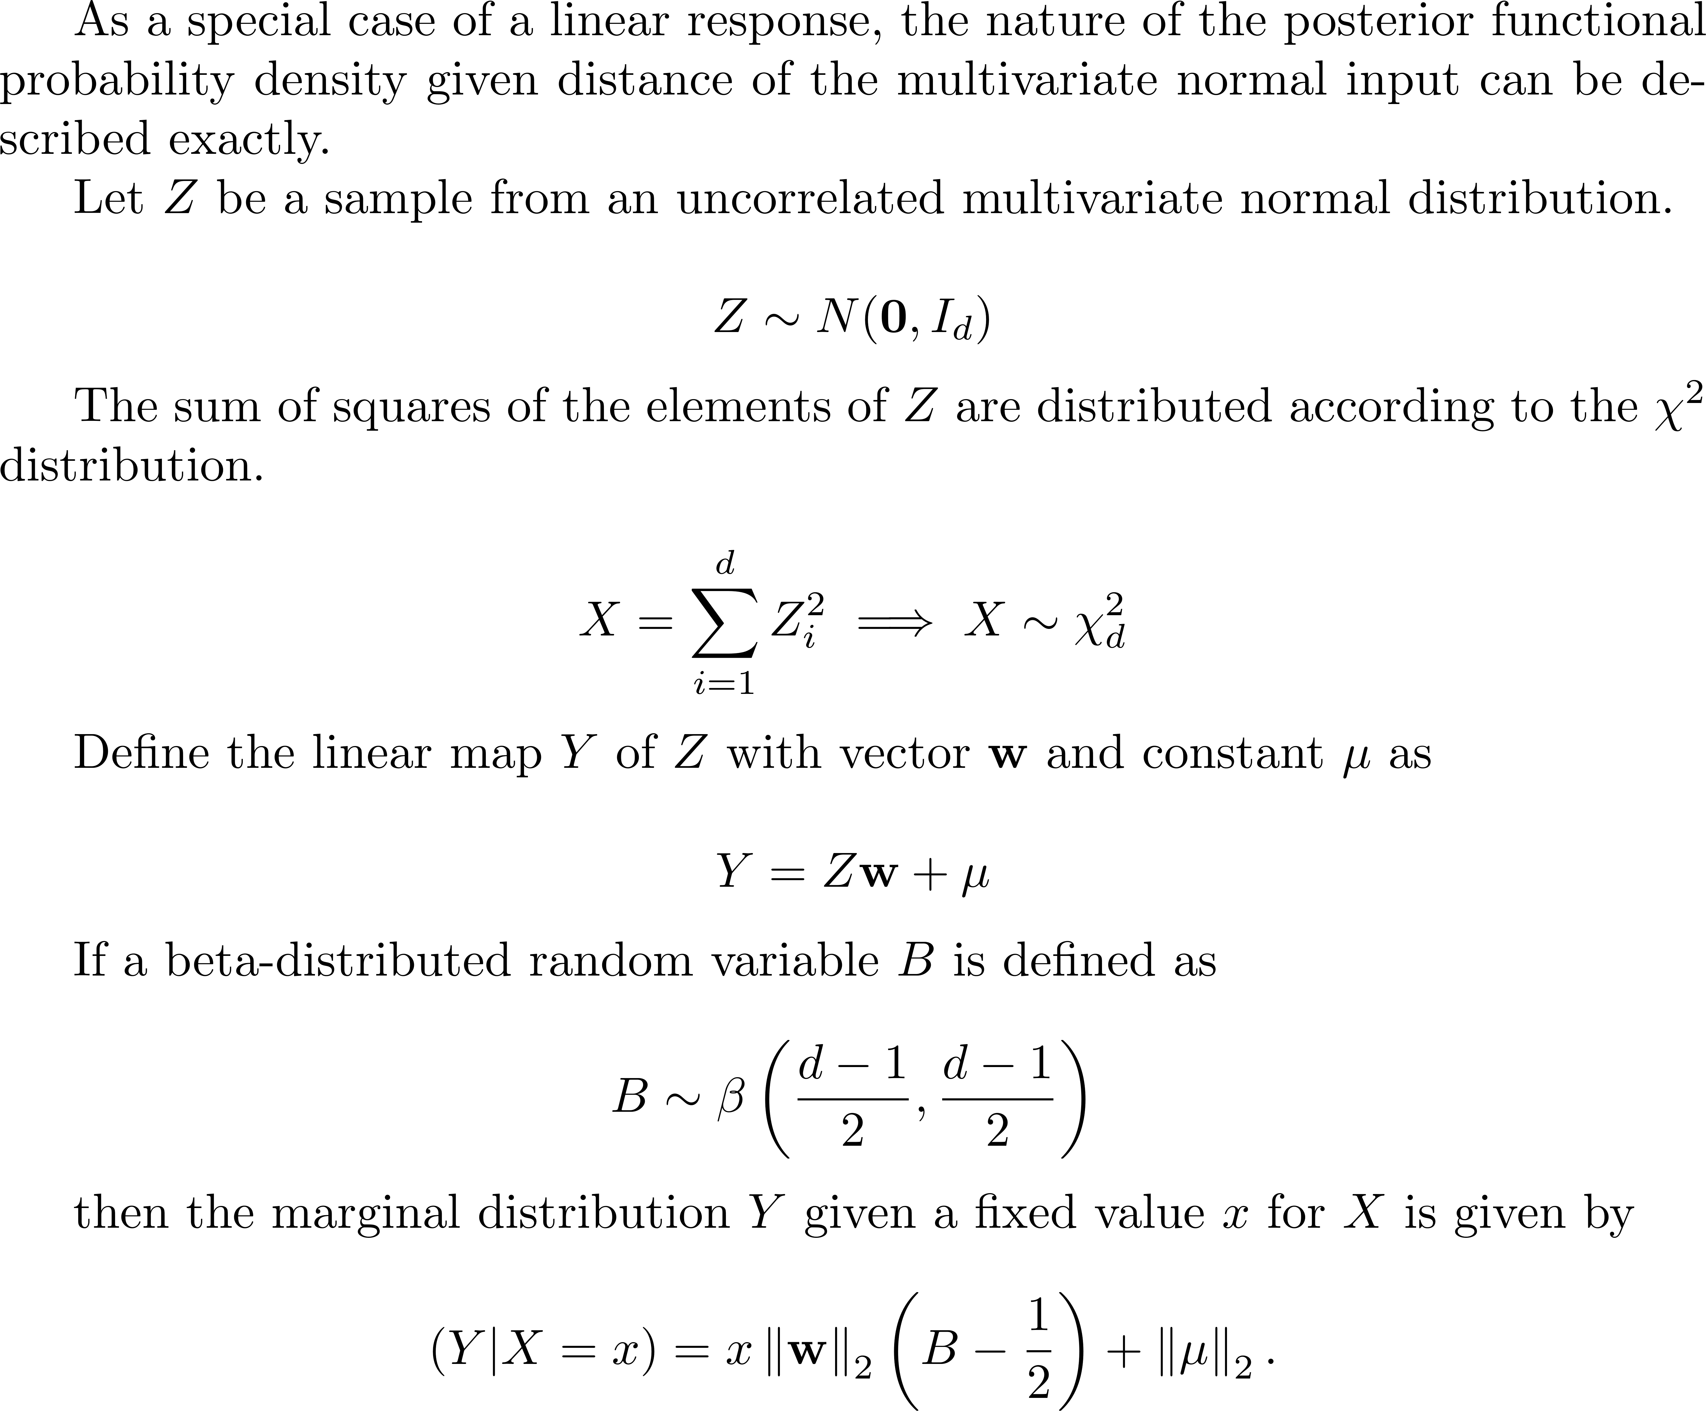
Monotonic Special Case : Linear Response (1/2)

Slide 19
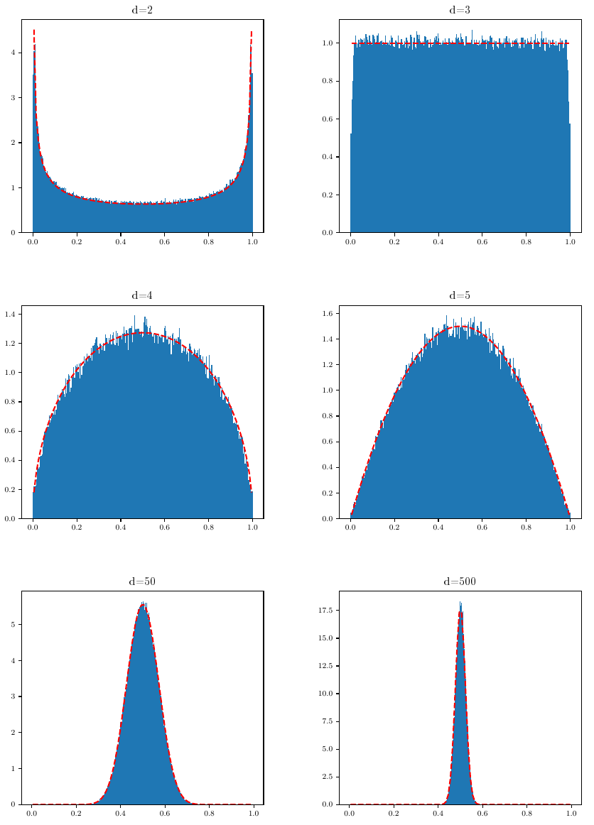
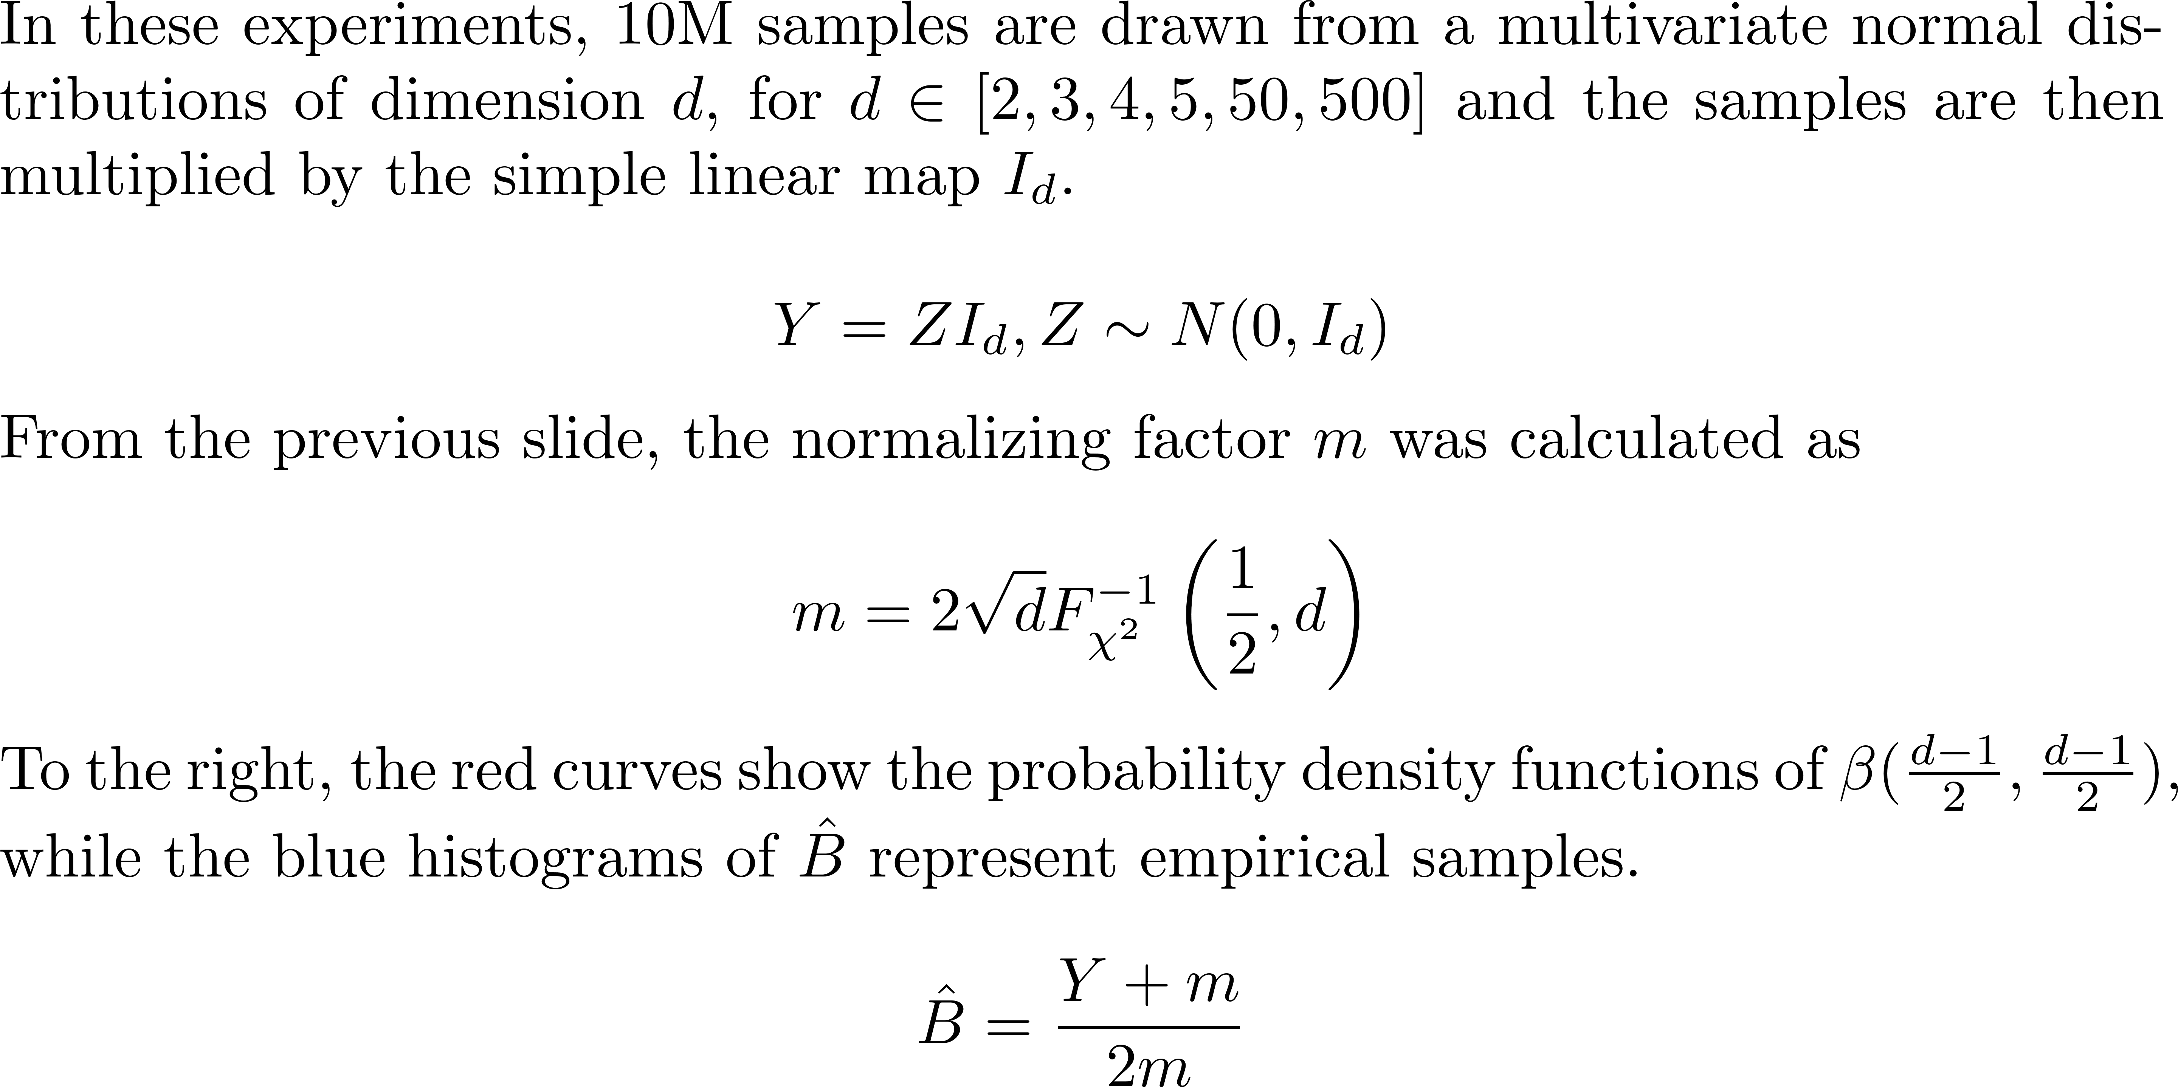
Monotonic Special Case : Linear Response (2/2)

Slide 20
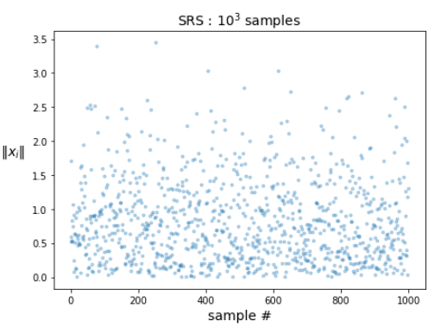
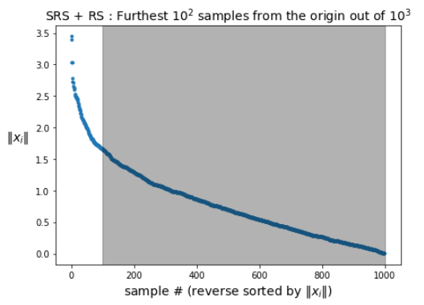
Drawing Distribution Tails with Rejection Sampling
Wish to simulate 10³ standard normal random samples, though have budget of only 10²
Which 100? Assuming function is monotonic, simulate samples furthest from the origin
This approach is called rejection sampling

Slide 21
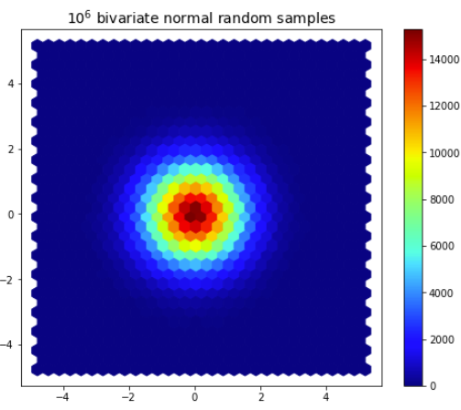
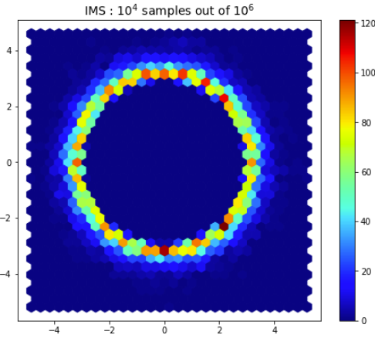
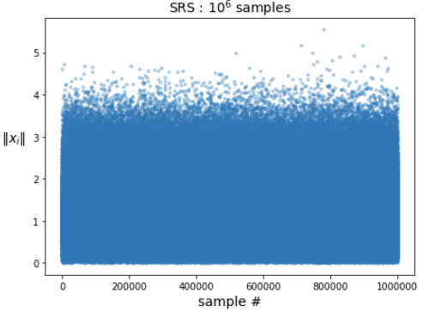
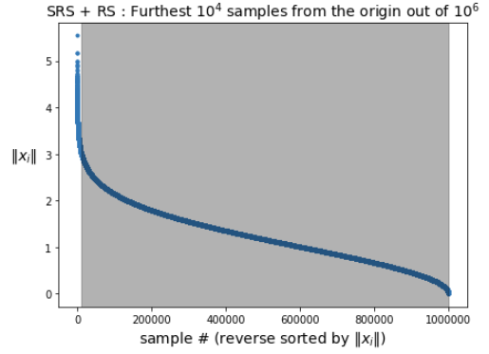
Rejection Sampling in 2D
Hexbin plots are useful for visualizing the distribution of 2D data

Slide 22
Rejection Sampling Pitfall / New Method Proposal
Suppose now we have the following scenario
Wish to simulate 10¹⁴ samples (roughly 7 sigma) and have the budget of 10⁶ simulations
Take a simple 6T circuit where each transistor is described by 7 random numbers (42 total)
Assume, on average, the generation of a normal random number takes 10ns
In total, we require over 11 hours† on 1000 cores just to generate 10¹⁴ random numbers to perform Rejection Sampling
Rejection Sampling does not scale well
Propose new method, In-Order Multivariate Sampling, to directly generate tail samples efficiently
† 10 x 10⁻⁹ x 42 x 10¹⁴ / 60 / 60 / 1000 ≈ 11.7 hours

Slide 23
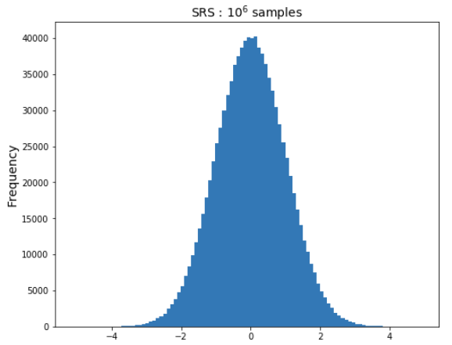
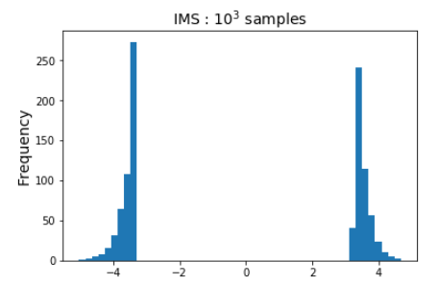
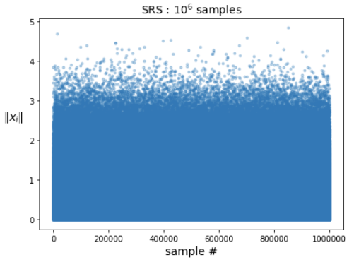
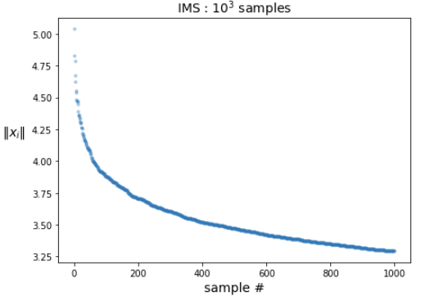
Simple Random Sampling vs. In-Order Multivariate Sampling : 1D

Slide 24
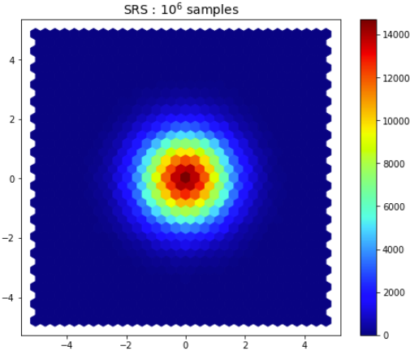
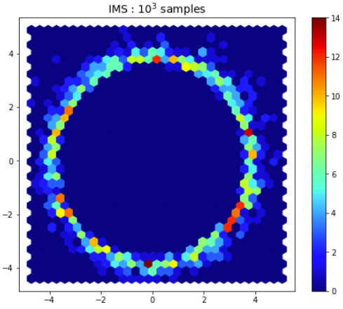
Simple Random Sampling vs. In-Order Multivariate Sampling : 2D

Slide 25
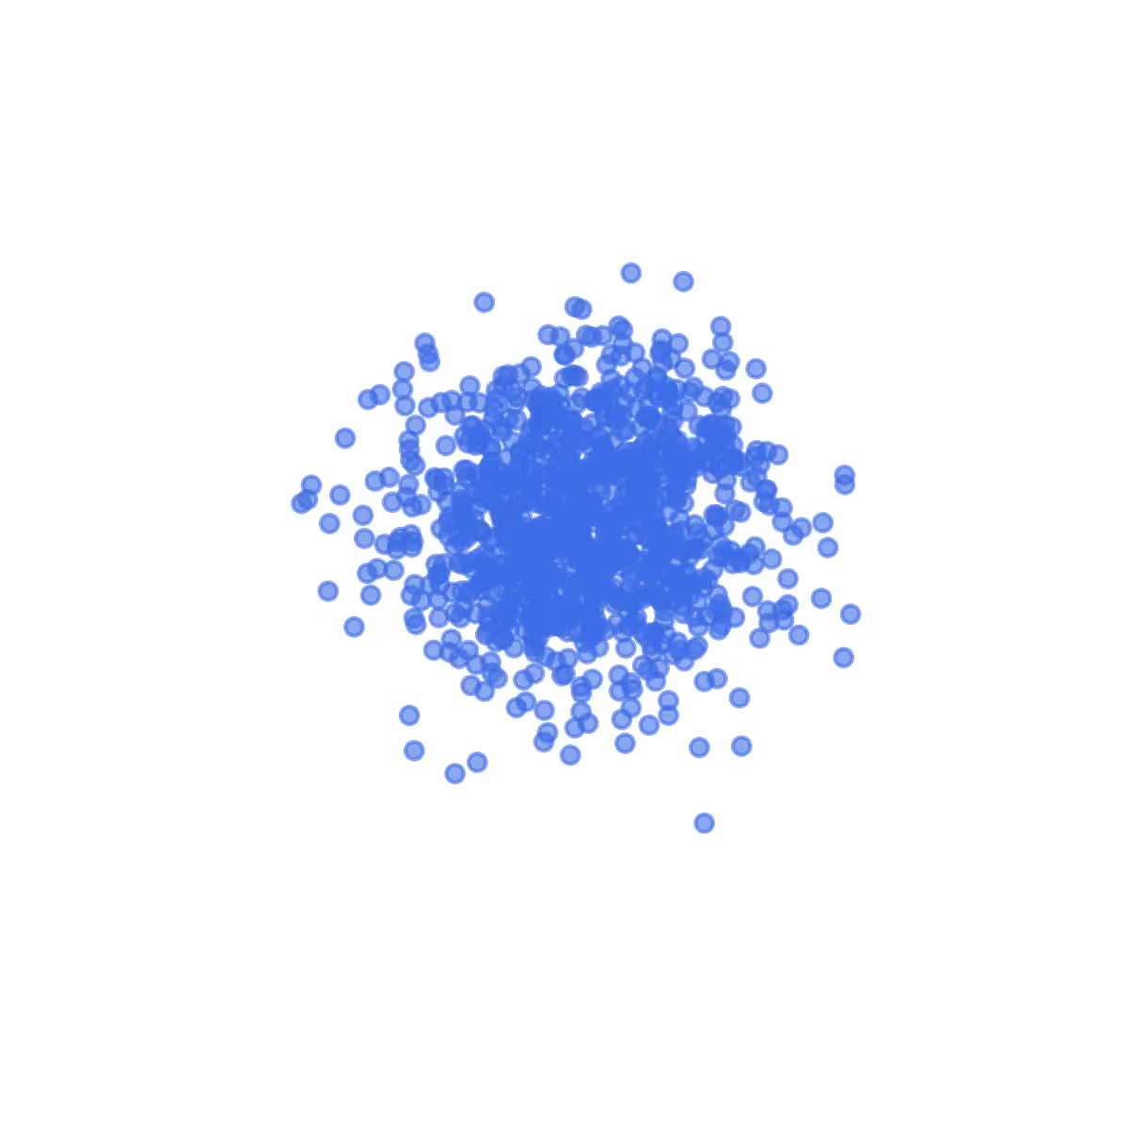
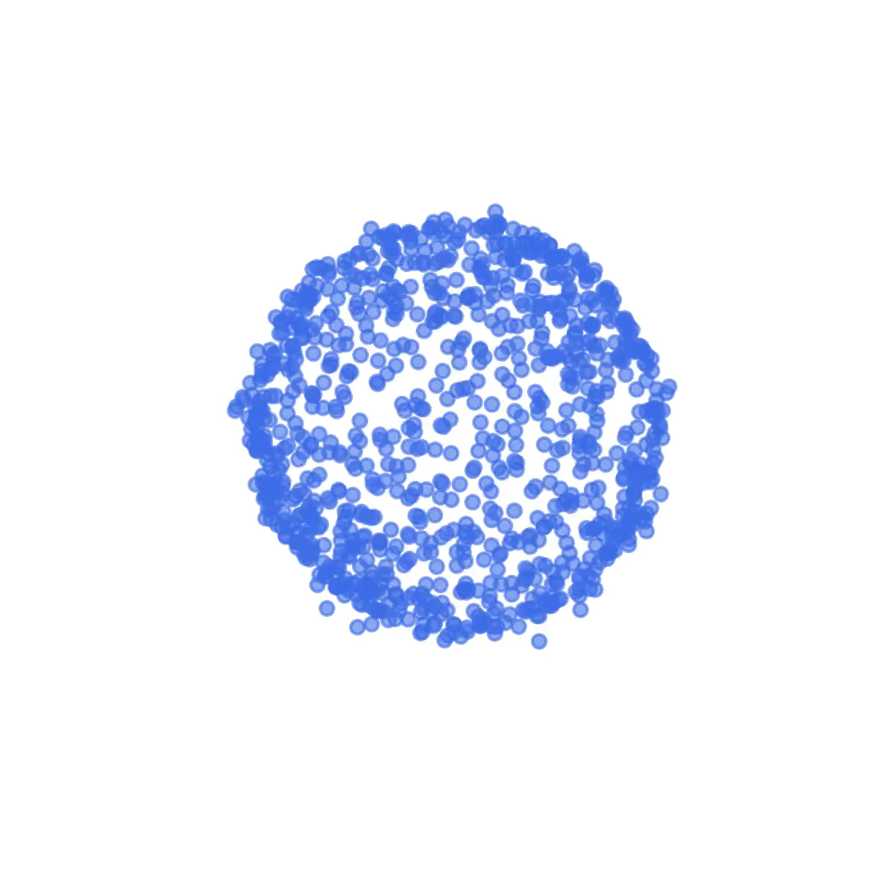
Simple Random Sampling vs. In-Order Multivariate Sampling : 3D
SRS:10³ Samples
IMS:10³ Samples
(of 10⁹)

Slide 26
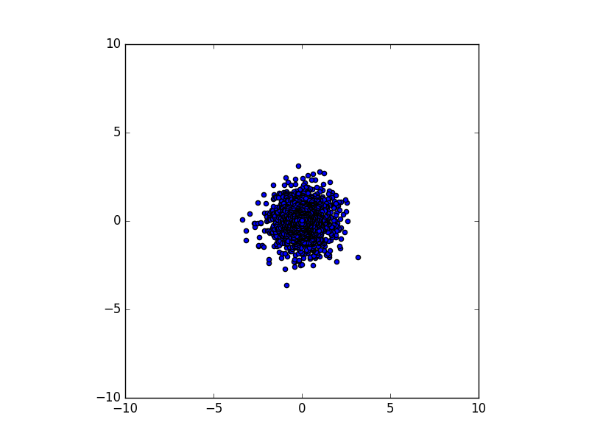
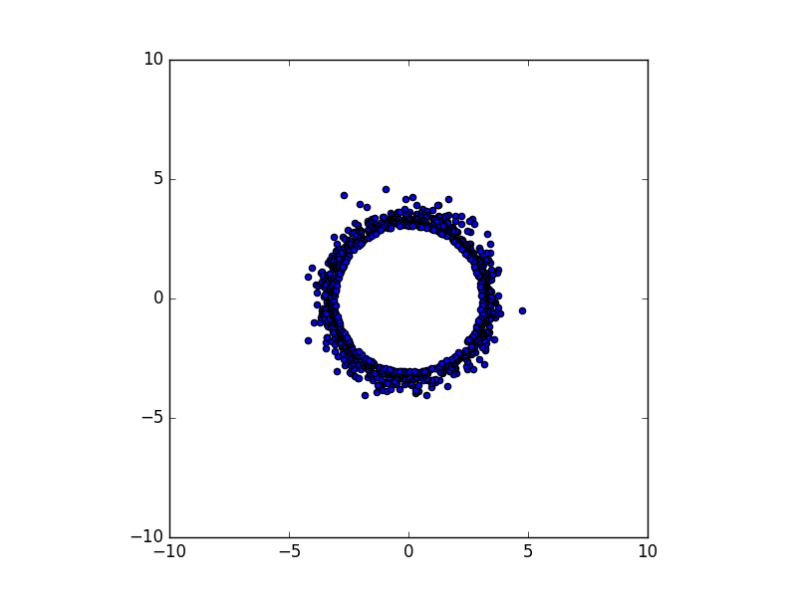
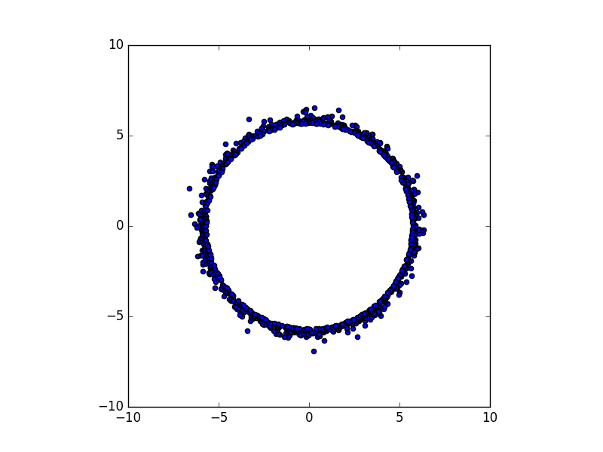
In-order Multivariate Sampling : Increasing Distribution Size 2D Examples
x2 distance from mean
x1 distance from mean
First 1000 of 1000 samples First 1000 of 100K samples First 1000 of 10B samples
(all samples)

Slide 27
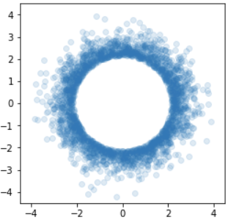
Concepts of In-order Multivariate Gaussian Sampling
The gaps between uniformly distributed random samples are exponentially distributed
Uniform random samples may be drawn in pre-sorted order
The distances from the origin squared of multivariate standard normal distributed random variables are Chi-square distributed
By inverse transform sampling, Chi-square random samples may be drawn in pre-sorted order
Simple Random Samples of the multivariate standard normal may be re-normalized by the distance found in previous step
Multivariate standard normal random variables may be drawn in pre-sorted order
Bentley, Jon Louis, and James B. Saxe. "Generating sorted lists of random numbers." ACM Transactions on Mathematical Software (TOMS) 6.3 (1980): 359-364
Kitagawa, Genshiro. "Monte Carlo filter and smoother for non-Gaussian nonlinear state space models." Journal of computational and graphical statistics 5.1 (1996): 1-25.
Pearson, Karl. "On the Criterion that a Given System of Deviations from the Probable in the Case of a Correlated System of Variables is Such that it Can be Reasonably Supposed to have Arisen from Random Sampling." Breakthroughs in Statistics. Springer New York, 1992. 11-28.
Muller, M. E. "A Note on a Method for Generating Points Uniformly on N-Dimensional Spheres." Comm. Assoc. Comput. Mach. 2, 19-20, Apr. 1959.

Slide 28
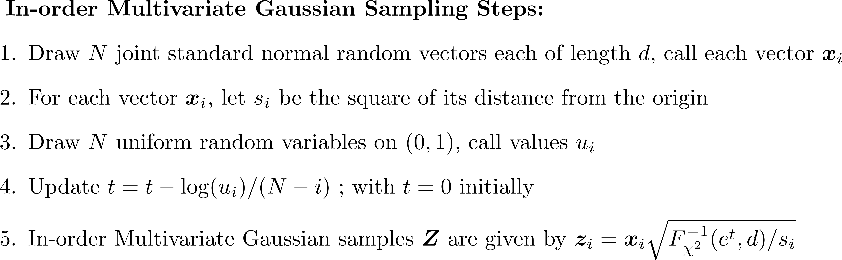
Drawing In-order Multivariate Gaussian Samples

Slide 29
Rare Monte Carlo Case Selection Approaches
Naïve : Generate and store all 10B samples, sort, then choose furthest 1K from origin
Improved : Generate 10B samples saving furthest 1K from origin in priority queue during generation
Our method : Only generate 1K samples furthest from origin
Requirements | Naïve | Improved | Our Method
# Samples Generated | 10B | 10B | 1K
# Samples Stored | 10B | 1K | 0
# Samples Sorted | 10B | 0 | 0
Simulation Time | ~8 hours* | ~3 min | <1sec
Storage | 4TB | 8KB | 0
* projected (not enough memory on test system to perform simulation)

Slide 30
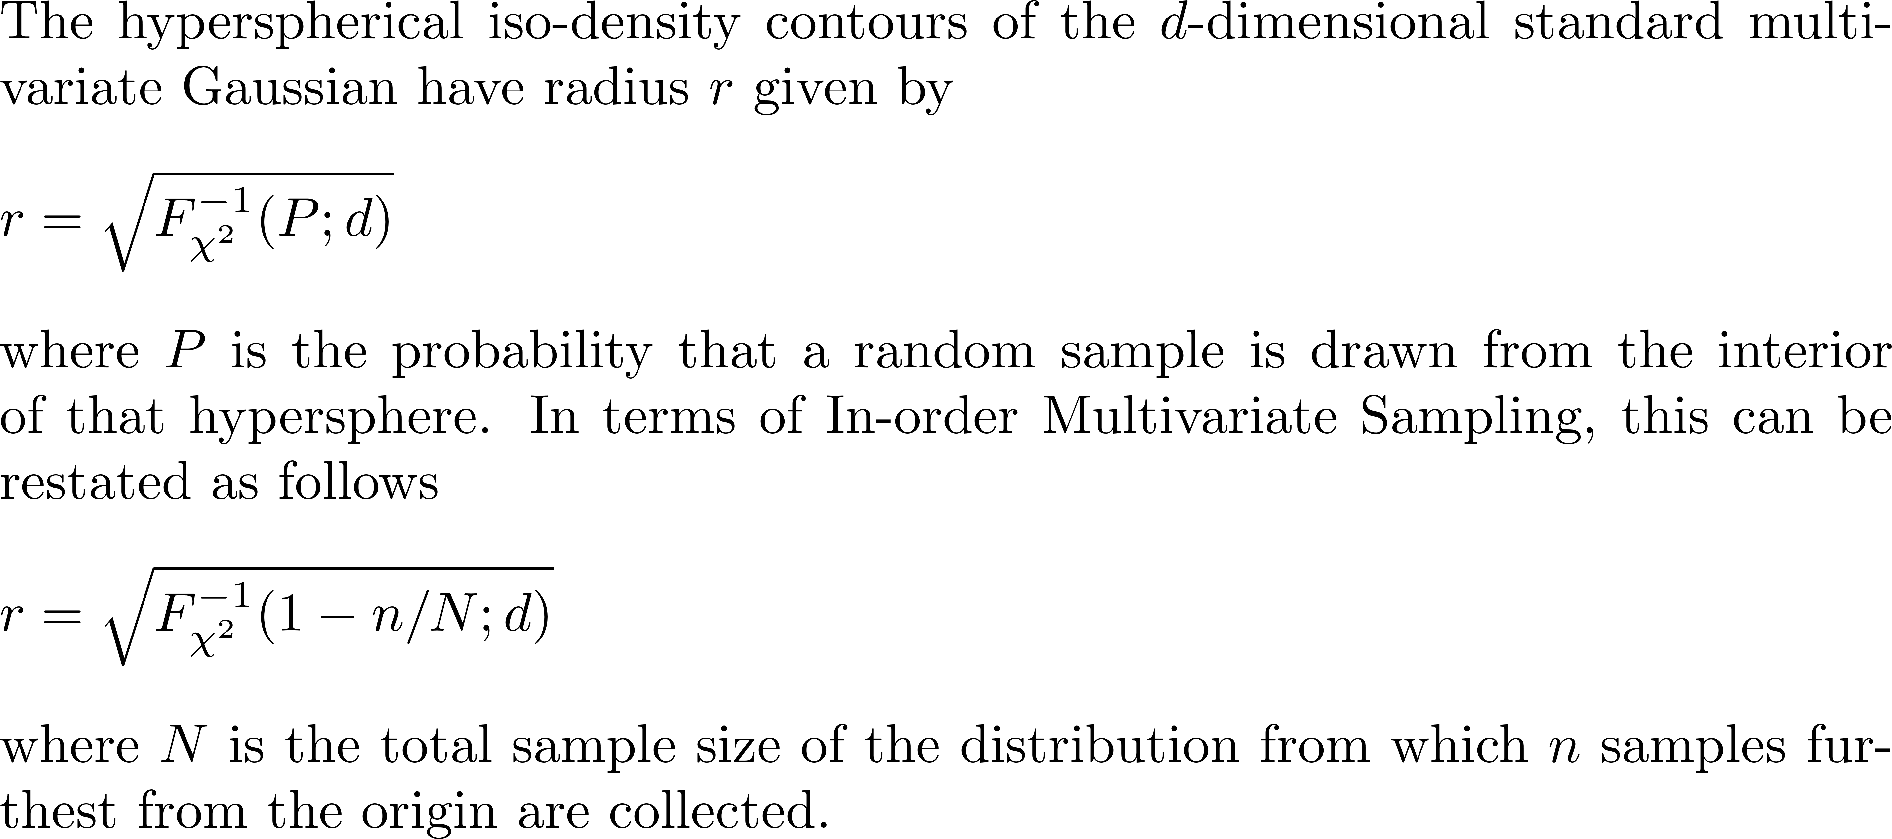


Relationship between probability density and hypersphere radius

Slide 31



Reliability Analysis : Example Calculations

Slide 32
Sampling Method Extensions
Correlated Sampling
Correlation between input independent random variables
Directional Sampling
Increasing concentration of samples along a provided directional axis by the von-Mises Fisher distribution ; useful for adaptive sampling
Mixture Sampling
Combining Hyperspheric Uniform Sampling and In-order Multivariate Sampling

Slide 33



Sampling with Correlated Variables

Slide 34



Directional Sampling : von Mises-Fisher Distribution (vMF)
Banerjee, Arindam, et al. "Clustering on the unit hypersphere using von Mises-Fisher distributions." Journal of Machine Learning Research 6.Sep (2005): 1345-1382.

Slide 35











Directional Sampling: 2D Example on Unit Circle
Distribution on Unit Circle (1K samples)
Angular Density
(100K samples)

Slide 36




Uniform Radial Density + vMF
Distribution of 10³ von Mises-Fisher samples with uniform radial density within the unit circle

Slide 37




Directional In-order Sampling (IMS + vMF)
Distribution of 10³ von Mises-Fisher samples furthest from the origin out of 10⁴

Slide 38

Custom Mixture Distribution Sampling
In-order Multivariate
Gaussian
Samples
Features :
In-order Multivariate Gaussian and/or Hyperspheric Uniform Random Sampling
Directional extension
Built-in mixture distribution capability
Distribution Parameters:
Hyperspheric boundary
Volumetric
Samples
Parameter name | Description | Default | Range | Comment
N | Total number of MC samples | No default | Positive Integer
d | Dimension (number or IRVs) | No default | Positive integer | Could be the number of dominant IRVs
sigma | Quantile of the standard normal associated with the hypersphere’s interior probability content | 4 | Positive real | The number of virtual samples ‘N’ and the (implicit) probability ‘P’ of the first outer sample (furthest from the origin) are determined by ‘n’ and ‘sigma’
g | Radial density gradient parameter | TBD (1.0 or ~0.5 ) {need eval of higher dimension behavior, may later depend on ‘d’} | Non-negative real | g=0 : samples distributed on hyperspheric surface only 0<g<1 : samples distributed with lower probability density near origin g=1 : samples distributed with uniform density within hypersphere g>1 : samples distributed with higher probability density near origin
n | Number of samples beyond the hyperspheric boundary | 0 | Non-negative integer | Behavior of the jth MC sample index: j<=n : sample beyond hypersphere (drawn in sorted order from a virtual ‘N’ sample multivariate Gaussian from the furthest from the origin sample inward) j>n : sample within hypsphere (drawn from volumetric distribution with radial density gradient param ‘g’) If J is the total number of samples drawn (draws can be incremental), then we have J>n=0 : samples within hypershere only J>n>0 : mixture sampling (‘n’ samples beyond hypersphere, ‘J-n’ within) J<=n: samples beyond hypersphere only
kappa | Directional concentration | 0 | Non-negative real number | Only used with adaptive sampling
v | Direction vector | [0,0,...,0] (length d) | Vector of unit or zero length

Slide 39


Mixture Distribution Examples 1/3
N | g
Volumetric Sampling
Parameter name | Description
N | Total number of MC samples
d | Dimension (number or IRVs)
sigma | Quantile of the standard normal associated with the hypersphere’s interior probability content
g | Radial density gradient parameter
n | Number of samples beyond the hyperspheric boundary
kappa | Directional concentration
v | Direction vector

Slide 40


Mixture Distribution Examples 2/3
n | sigma | symmetric mixtures
In-Order Multivariate Gaussian
+ Symmetric Mixtures
Parameter name | Description
N | Total number of MC samples
d | Dimension (number or IRVs)
sigma | Quantile of the standard normal associated with the hypersphere’s interior probability content
g | Radial density gradient parameter
n | Number of samples beyond the hyperspheric boundary
kappa | Directional concentration
v | Direction vector

Slide 41



Mixture Distribution Examples 3/3
v | kappa | directional mixtures
Directional Sampling
+ Directional Mixtures
Parameter name | Description
N | Total number of MC samples
d | Dimension (number or IRVs)
sigma | Quantile of the standard normal associated with the hypersphere’s interior probability content
g | Radial density gradient parameter
n | Number of samples beyond the hyperspheric boundary
kappa | Directional concentration
v | Direction vector

Slide 42


Hyperspheric Uniform Sampling Extension: A Reduction in Required RVs per Sample

Slide 43


In-order Multivariate Gaussian Sampling Extension: A Reduction in Required RVs per Sample

Slide 44
Summary : Alternative Sampling Methods
Supporting material
Introduction of Simple Random Sampling of the multivariate normal (SRS)
Two alternatives : Uniform Random Sampling (URS) and Hyperspheric Uniform Random Sampling (HURS)
Monotone responses preserve MC sample rarity from input to output
Special case of linear response has a well-defined distribution given distance to origin
Primary contribution
SRS-like distribution sampled from the outside inward : In-Order Multivariate Sampling (IMS)
Secondary contributions
Sampling extensions: Correlated, Directional, Mixture
Enhancement in sample generation for HURS and IMS

Slide 45
Topic #2 : Modeling and Characterization of Quadratic Forms

Slide 46

Use of Surrogates in Monte Carlo Simulation
Common Monte Carlo Simulation Tasks
Finding probable measure failure cases
Calculating properties of the measure distribution
Mathematical Surrogates Models
Fit to MC results, provides a rough approximation
Fast performance, useful for filtering
Distribution properties may be available

Slide 47


Mathematical Surrogate Models
True System
Surrogate
Model
Surrogate Model Examples:
Linear -> characterization is straightforward
Quadratic -> characterization is tractable (our focus)
General model (SVM, CNN, Random Forest, ...) -> characterization is impractical

Slide 48





Quadratic Modeling and Characterization Dependencies
Raw Data
Legendre polynomial fitting with LASSO
Functional Model (quadratic)
Eigenvector decomposition
Distributive Model (linear)
Raw Moments
Central Moments
Cumulants
Approximation by Cornish-Fisher expansion
Quantiles

Slide 49


Multivariate Data Modeling with Legendre Polynomials
High order polynomial data fitting can be unstable
Legendre polynomials
Orthogonal polynomial basis
Small perturbations in the data results in small coefficient updates
Partial fit possible with series truncation
In 1 dimension :
Legendre polynomials of order 0..N which form a 1D orthogonal basis on -1≤x≤1 in the N^{th} degree univariate polynomial space
Solve Legendre coefficient vector of length N+1
In higher dimensions:
To represent 2 or more dimensions, we consider the tensor product of 1D spaces as defined previously
Solve as in 1D case, except number of Legendre coefficients become (N₁+1)*(N₂+1)*..*(N_{d}+1) in d dimensions
Useful for generation of sparse quadratic models

Slide 50


Example : Booth Function Definition

Slide 51





Sample Distribution / Moments
Raw Moments
Central Moments
Also, quantiles readily calculable given sorted y

Slide 52




Example : Booth Function : Analytic Distribution
We now perform a transformation of the quadratic system of joint-normal random vectors to a linear system of independent chi-squared and normal random variables
Recall
Now define the rows of square matrix U comprised of the orthonormal eigenvectors of C as follows
Completing the transformation, we have
Now y can be expressed as a linear system of two independent chi-squared random variables

Slide 53


Analytic Raw Moment Calculation
Mathai, Arakaparampil M., and Serge B. Provost. Quadratic Forms in Random Variables: Theory and Applications. Dekker, 1992.

Slide 54



Analytic Central Moment Calculation

Slide 55


Analytic Quantiles (1/2)
Cornish, Edmund A., and Ronald A. Fisher. "Moments and Cumulants in the Specification of Distributions." Revue de l'Institut international de Statistique (1938): 307-320.
Rouvinez, Christophe (1997). Going Greek with value-at-risk, Risk, 10 (2), 57-65

Slide 56




Analytic Quantiles (2/2)

Slide 57

Example : Univariate Linear

Slide 58

Quadratic Example : Univariate Quadratic

Slide 59


Example : Multivariate Exponential and Quadratic

Slide 60
Summary : Modeling and Characterization of Quadratic Forms
Supporting material
Sparse quadratic modeling via Legendre polynomials
Linearization via eigenvector decomposition
Raw moments calculated via linearized quadratic model
Central moment computation from raw moments
Cumulant calculation from central moments
Quantile estimation via Cornish-Fisher expansion from cumulants
Primary contribution
Established well-defined flow which begins with data and ends with a quadratic model and its statistical properties including raw and central moments, cumulants, and quantiles

Slide 61
Topic #3 : Moment Calculation from Quantile Information

Slide 62




Moment Calculation Given Sample Data
The above equations can be used when raw data is available and sample size is not too large.

Slide 63
Moment Calculation Given Quantile Information
When the QQ plot is available (i.e. the empirical cumulative distribution function), but the data is not available can moments be calculated?
Mean
Standard Deviation
Skewness
Kurtosis
?

Slide 64
Piecewise Normal Assumption
A subset of the discrete points which make up the QQ plot can be connected by straight line segments
For illustrative purposes, four points are chosen and connected in the plot to the right
In practice, all points can be connected in the same way
A "piecewise linear" QQ plot translates to a "piecewise normal" plot in the probability domain
The piecewise normal assumption provides a well-defined value for the CDF along the continuous interval between the minimum and maximum sample values

Slide 65


Moment Calculation via Analytic Integration of CDF
Given a finite dataset, subtracting minimum sample from all samples yields strictly non-negative samples
Mean must be adjusted, but then only need utilize first case above
Following slides provide a simplified expression using piecewise normal assumption

Slide 66

Moment Calculation : From the general form to the non-negative sample case

Slide 67
Moment Calculation : Raw Moments + Mean, Standard Deviation, Skewness, and Kurtosis

Slide 68


Examples : Standard Normal / Log Normal
 |  | (reference)
Standard Normal |  | Sample | Quantile | Error
N=3K | mean | 1.5436E-02 | 1.5435E-02 | 0.007%
 | std dev | 9.9299E-01 | 9.9294E-01 | 0.005%
 | skewness | 2.2831E-02 | 2.2785E-02 | 0.202%
 | kurtosis | 3.0721E+00 | 3.0705E+00 | 0.052%
 | mean | 1.6504E+00 | 1.6504E+00 | 0.004%
 | std dev | 2.1053E+00 | 2.1047E+00 | 0.030%
 | skewness | 3.9850E+00 | 3.9799E+00 | 0.127%
 | kurtosis | 2.6148E+01 | 2.6070E+01 | 0.299%
Log Normal
N=10K

Slide 69
Experiment Setup for Distribution of Moments across Trials
Several distributions were selected including Normal, Weibull, and Chi-Squared
10K samples were taken in 10K trials
Sample and quantile-based moment calculation methods were applied to each trial
The distribution of results for each moment method are compared, results on following 2 slides

Slide 70



Sample vs. Quantile Based Moment Calculation (1/2)
Normal
Weibull
Chi-Squared
Good match between sample and quantile-based moment distributions

Slide 71





Sample vs. Quantile Based Moment Calculation (2/2)
Normal
Weibull
Chi-Squared
Good match between sample and quantile-based moment distributions

Slide 72
Summary : Moment Calculation from Quantile Information
Supporting material
Raw moment calculation via CDF Integration
Mean, Standard Deviation, Skewness and Kurtosis calculation via Raw Moments
Primary contribution
Derivation of closed form equations for Mean, Standard Deviation, Skewness and Kurtosis given only Quantile Information which relies on piecewise normal approximation

Slide 73
Circuit Applications

Slide 74

In-Order Multivariate Sampling: Monotonicity Verification
16nm Inverter Example
X-axis is a given IRV value
Y-axis is the circuit response (delay in this case)
In-Order Multivariate Sampling works when rare samples in the output space correspond with rare samples in the input space
It was shown that the this is satisfied when the response is monotonic
The monotonic property was studied for several circuits and no violations were found
With monotonic circuit response, the In-Order Multivariate Sampling can be employed

Slide 75

In-Order Multivariate Sampling: Probabilistic Verification
7nm Inverter Example
Delay value posterior probability distribution of conditional on sample distance from origin
Sample count grouped by sample distance from origin

Slide 76

Quadratic Forms : Circuit Verification
0.2μm Operational Amplifier Example
Leakage power of Operational Amplifier
Quadratic form is better able to model circuit behavior than the linear form

Slide 77

Sample vs. Quantile Moment Calculations
0.2μm Operational Amplifier Example
 |  | (reference)
 |  | Sample | Quantile | Error
# MC Samples = 1K | mean | -1.1097E+01 | -1.1097E+01 | -0.003%
# Plot Points = 1K | std dev | 1.9728E+00 | 1.9701E+00 | 0.135%
 | skewness | 9.5538E-02 | 9.2975E-02 | 2.719%
 | kurtosis | 3.0289E+00 | 3.0214E+00 | 0.247%
# MC Samples = 10K | mean | -1.0994E+01 | -1.0994E+01 | -0.001%
# Plot Points = 2530 | std dev | 2.0130E+00 | 2.0127E+00 | 0.013%
 | skewness | -4.8935E-02 | -4.8865E-02 | -0.143%
 | kurtosis | 3.0257E+00 | 3.0230E+00 | 0.089%
For sample sizes of 1K and 10K, the sample and quantile moment results are within 2.8% and 0.15%, respectively

Slide 78


Moment Computation from Quantile Information: Circuit Verification
7nm Inverter Example
Comparison of sample and quantile-based moments
The sample and quantile moment computation methods agree for practical circuit measurements

Slide 79
Conclusions

Slide 80
Thesis Contributions
In-order Multivariate Sampling (IMS)
Formulation of a novel method to draw samples from the multivariate standard normal distribution in pre-sorted order
Extensions to IMS : mixture with volumetric sampling, directional via von Mises-Fisher distribution, correlated variables
Flow of Statistical Analysis of Quadratic Forms
Fit quadratic models to data using sparse Legendre polynomials
Represent the quadratic form as a sum of normal and chi-square distributions
Calculation of raw/central moments and cumulants
Estimation of quadratic model quantiles via Cornish Fisher expansion
Moment Calculation from Quantile Information by Analytic Integration of CDF

Slide 81

Industrial Application of Thesis Contributions
Capabilities shipped in product in 2018 (Synopsys)
Alternative Monte Carlo Sampling Methods
In-order Multivariate Sampling (IMS)
Hyperspheric Uniform Random Sampling (HURS)
Moment Calculation from Quantile Information

Slide 82
Possible Future Work
Extension of In-order multivariate sampling to distributions other than the multivariate standard normal

Slide 84
Statistical Background

Slide 85

Probability Density Function (PDF)
Process variation is often modeled through the Gaussian or normal probability density function
All density functions are non-negative at all x and the integral under the curve is 1
Representing process variables by a normal density is often an approximation
Example : For circuits simulation, although IRV probability is non-zero from -∞ to +∞, physical quantities like channel length have limited range
Non-physical values seldom arise in simulation because variation in production processes is small
R code
x = seq(-4, 4, length = 1000)
plot(x, dnorm(x))

Slide 86

Area under the PDF
Area under the density function to a specified ordinate x gives the probability of an event
Example: Area of the shaded region is the probability that the value of the random variable x is less than 2
For the normal distribution
p = pnorm(2)

Slide 87
Cumulative Distribution Function (CDF)
The plot shows the value of the integral under the density curve from –∞ to a particular ordinate x, say p = Φ(x) for the normal density
It is called the cumulative distribution function
It ranges from zero to one and is weakly monotonic (monotonically non-decreasing)
The probability of the random variable being less than a certain value can be determined directly from the plot
x = seq(-4, 4, length = 1000)
plot(x, pnorm(x))

Slide 88
Statistical Measures
In addition to plots for distributions, a few associated quantitative values are also useful
Moments (mean, standard deviation, skewness, kurtosis)
Skewness is zero for symmetric distributions
Kurtosis has value 3 for normal distributions
Quantiles
Robust estimates of the cumulative distribution function (CDF)
Q01 and Q99 estimate the coordinates where the CDF has value 0.01 and 0.99 respectively
Q50 is the median

Slide 89
Statistical Measures (Standard Normal Distribution)
mu = 0 Mean = 0 Q05 = -1.64
variance = 1 Median = 0 Q95 = 1.64
Skewness = 0 Mode = 0
Kurtosis = 3
0.95
Q05
Q95
0.05
Q05 and Q95 are the 5% and 95% quantiles

Slide 90

Statistical Measures (log-Normal Distribution)
Mode
Median
Mean
Q01 and Q99 are the 1% and 99% quantiles
Q01
Q99

Slide 91
Transformations on the Cumulative Distribution Function
The cumulative distribution function is repeated in Fig. 1
The y-axis range is between zero and one
While the CDF is for a normal distribution, the shape for other distributions is similar
The CDF is close to zero or one in the tails, but the values are hard to resolve on the usual y-axis scale
Fig. 2 shows the CDF with the y-axis on the log scale
While it is possible to resolve values close to zero, values close to one are still compressed
Fig. 3 shows a scaling with tanh⁻¹(2y-1)
Values close to zero and one are resolved
Can we do better?
Fig. 4 shows the probit transformation (Φ⁻¹) which changes the y-axis such that the CDF curve becomes a 45° straight line for a standard normal distribution
The probability axis is shown on the right side and ranges over many orders of magnitude
It is customary to use the equivalent ordinates of the standard normal CDF on the left axis for ease of interpretation
The same transformation will be used later for QQ plots
Tail probabilities are resolved well on this plot and departures from a normal distribution are easily detected visually
x = seq(-4, 4, length = 1000)
plot(x, qnorm(pnorm(x)))

Slide 92
Comparing Distributions
Given samples from a distribution, is the underlying distribution normal?
Median ~ Mean, Sigma ~ MAD, Skewness ~ 0, Kurtosis ~ 3
Given data from two random experiments, do they arise from the same distribution?
A formal test of hypothesis can be used
The Kolmogorov-Smirnov (K-S) test is the most common one for arbitrary distributions
A quick qualitative idea can be obtained from the QQ plot
Data are expected to lie on or close to a 45 degree line if the response is standard normal
Some departure in the tail regions is typical
While strongly different distributions are easily identified, it is difficult to distinguish between similar distributions
QQ plots for some typical response distributions are shown on the next two slides
While the plots for non-normal distributions are no longer straight lines, the tail probabilities can still be resolved easily

Slide 93
Density and Q-Q Plots for Typical Distributions

Slide 94
Sampling
For circuit simulation application, while the distribution of the process variables is provided by the foundry and generally assumed to be normal, the distribution of the response is usually not known analytically
The response distribution and appropriate statistical measures like moments and percentiles are determined by Monte Carlo sampling
One mimics the manufacturing process on the computer by
Generating random numbers for the process variables
Simulating the circuit with these random variables
Post-processing the output once sufficient number of samples have been simulated

Slide 95
Displaying Monte Carlo Results
While the distributions of the independent process random variables (IRVs) are provided by the foundry, the distribution of the circuit response is unknown and may not have an analytic form
Monte Carlo simulation enables us to generate samples from the IRV, run simulations, and find corresponding values for the response
Let the top left figure show one such response
Here taken as samples from N(1, 1)
The x-axis gives sample values and the y-axis is the corresponding Monte Carlo sweep index
Data summary is shown in the top right as a histogram which is an approximation to the PDF
A different view is obtained if we sort the data and permute the associated index, bottom left plot
Finally, we approximate the CDF by dividing the y-axis by the number of samples, bottom right plot
This is called the Empirical CDF (ECDF) and is an approximation to the CDF for the response density

Slide 96
Displaying Monte Carlo Results (Continued)
As with the cumulative distribution function, it is difficult to read values of small and large probabilities on the ECDF plot
The probit transformation is applied to the y-axis, mapping probabilities to equivalent ordinates of the standard normal distribution in the top plot
This stretches the y-axis and leads to near straight lines for samples from normal distributions
The same transformation can be used with samples from non-normal distributions
The bottom figure is for samples from a log-normal distribution
The curve no longer looks like a straight line
However, the probit transformation still stretches the y-axis and enables us to easily read small and large probability vales
The plot where the sorted sample values form the x-axis and the probit transformation of the sequence (1:N – 0.5)/N gives the y-axis is called the sample QQ plot where N is the sample size (Type = 5 in below reference)
N = length(x)
plot(sort(x), qnorm(((1:N)-0.5)/N))
R.J. Hyndman and Y. Fan: Sample quantiles in statistical packages. American Statistician, pp. 361–365, 1996.

Slide 97
Additional Q-Q Plot Examples

Slide 98
Probability and Sigma
Design engineers often define probability in terms of sigma of the standard normal distribution even when the distribution is non-normal
Statistical literature uses the term percentiles
Reliability engineers use parts per million (ppm) failures
Probabilities can range over many orders of magnitude while sigma values are usually small numbers between -7 and 7
The plot shows the mapping between sigma and probability
The sigma for the standard normal density will often be used to represent probabilities in the rest of the presentation
Probability
sigma = seq(1.5, 7, length = 1000)
plot(sigma, 1-pnorm(sigma), log = “y”)
Sigma

Slide 99
System and Component Reliability
Consider a system with multiple components
System functions only if all the components function (assuming there is no redundancy)
If component j has probability P_{j} of functioning correctly, the probability of the system functioning correctly is
If the system consists of K identical components, the system failure probability f_{s} is related to the component failure probability f_{c} by
The curves on the right shows this equation in chart form
Example: Let the system requirement be 3.5 sigma and let a particular component be replicated 10K times in the system then the component should be designed to 5.5 sigma (10K on the orange curve)
Large component sigma is
required for highly replicative circuits

Slide 100
QQ Plot - Confidence Intervals – 1
Let us draw a sample from a distribution and create a QQ plot for the data
Unlike the ideal probit plot, there is a small departure from a straight line due to the approximation of the distribution by a sample from it
N = 10000
x = r norm(N)
plot(sort(x), qnorm(((1:N)-0.5)/N))

Slide 101
QQ Plot - Confidence Intervals – 2
Let us repeat the experiment a few more times with different random number seeds and superpose the plots
The plots are not identical but are closer together in the middle and spread out towards the ends due to sampling errors

Slide 102
QQ Plot - Confidence Intervals – 3
The confidence interval, the grey shaded region in the figure, captures the statistical sampling error concept in a formal manner
When the confidence interval is 95%, the true QQ plot line will lie within the grey shaded region 95% of the time
The QQ plot confidence interval is based on the beta distribution for the order statistics
The y-axis range and the confidence interval width depend on sample size
The y-axis range increases and the confidence interval shrinks with increasing sample size
C. Clopper and S. Pearson: The use of confidence or fiducial limits illustrated
in the case of the Binomial. Biometrika, pp. 404-413, 1934.
R.S. Woodruff: Confi­dence intervals for medians and other position measures. JASA, pp. 635–646, 1952.
Notes:
The Confidence Interval is calculated as the Clopper-Pearson interval that appears under the topics of Order Statistics, also known as Distribution Free Statistics using the expressions
$$B\left(\frac{α}{2};x,n−x+1\right)<Q_{k}<B\left(1−\frac{α}{2};x+1,n−x\right)$$
Considering:
CI is the confidence level;
$α$ is the error quantile (or 1 – CI);
$x$ is $(k−0.5)$;
$n$is the number of trials (number of points in the data set),;
$B\left(p;v,w \right)$ is the pth quantile from a beta distribution with shape parameters $v$ and $w$.
The Use of Confidence or Fiducial Limits Illustrated in the Case of the Binomial
C. J. Clopper and E. S. Pearson
Biometrika Vol. 26, No. 4 (Dec., 1934), pp. 404-413

Slide 103


Error function : Definition and Integrals through Third Order

Slide 104




Error function : Definition and Integrals through Third Order
While more general than Owen's T function, the numerical approximation of S_{t}(x) for t>1 is unavailable

Slide 105
Summary : Integral of the Higher Order Error Function
Supporting material
Error function definition and integrals through third order
Primary contribution
Rearrangement of error function integral in terms of new function S_{t}(x)
It is a general solution, working for the integral of the error function to any positive integer power

